Slide 1






LOGISTICS PERFORMANCE INDEX (LPI) AGENTIC APPLICATION
A Graph Analytics Solution for Global Logistics
Presented by Gift Ahmed
Building the Next-Gen Agentic App with GraphRAG & NVIDIA cuGraph

Slide 2




Contents
1
2
Dataset & Business Problem
Introduction & Motivation
3
Converting Data to a Graph
4
Persistence and Loading in ArangoDB
5
Agentic Application for Natural Language Queries
6
Real-Time Demo

Slide 3


Introduction & Motivation
About Me:
Brief background in data science and logistics analytics
Why I Participated:
Passion for leveraging graph analytics to solve real-world supply chain challenges
Project Overview:
Building an agentic application to derive insights from the LPI dataset

Slide 4
Dataset & Business Problem
Dataset Description:
Logistics Performance Index (LPI) data covering metrics like customs, infrastructure, international shipments, logistics competence, and tracking & tracing
Data spans from 2007 to 2023, across multiple countries
Business Problem:
Assessing global logistics performance
Identifying strengths, weaknesses, and key influencers in supply chain networks

Slide 5
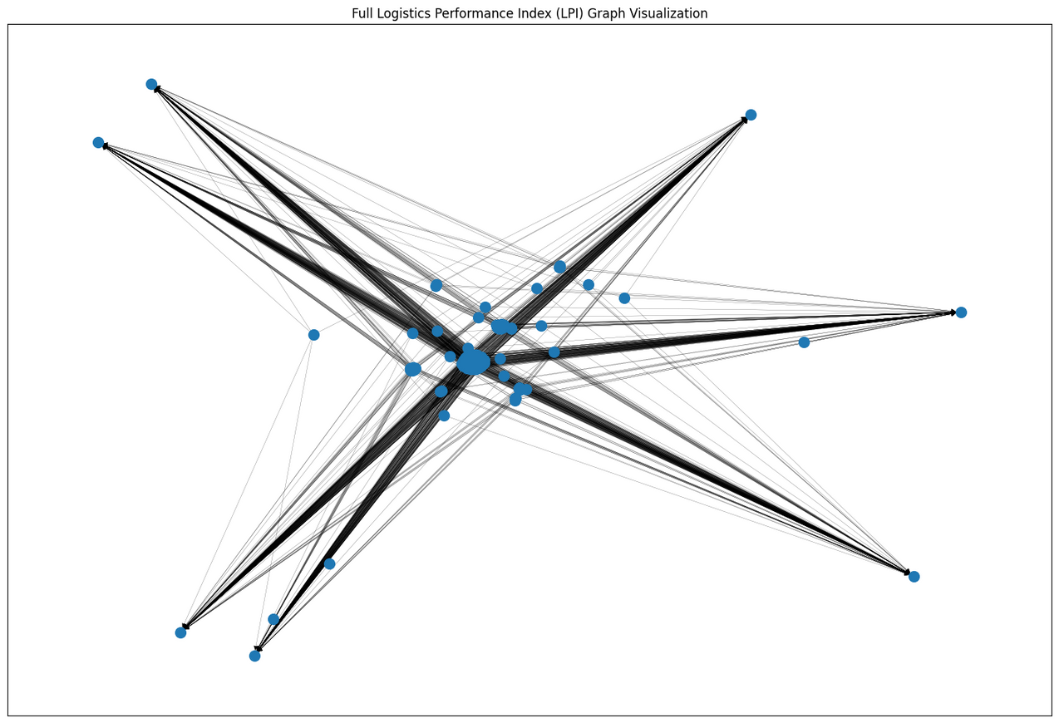
Converting Data to a Graph
Graph Model:Nodes: Country nodes and Year nodes
Edges: Represent relationships (e.g., a country's performance in a given year) with LPI metrics as attributes
Conversion Process:Data cleaning and preprocessing using Python/Pandas
Graph building with NetworkX

Slide 6

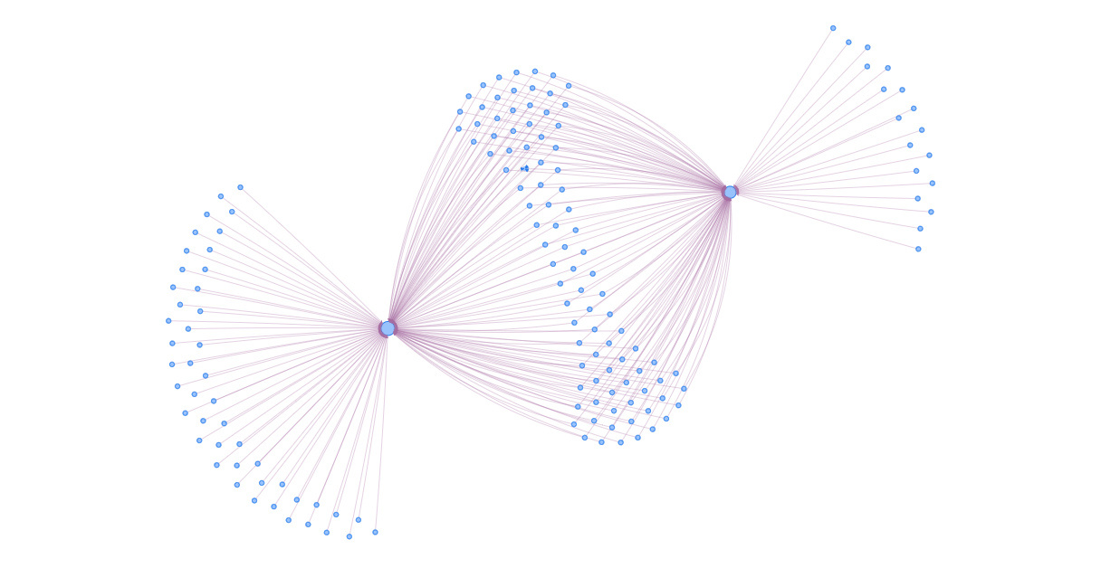
Persistence and Loading in ArangoDB
Graph Persistence:
How I stored the graph in ArangoDB (nodes and edges in separate collections)
Querying:
Using AQL to traverse and retrieve graph data

Slide 7
Agentic Application for Natural Language Queries
Overview:
Dynamic query processing using multiple tools:
Simple AQL Queries
Complex Analytics (NetworkX/cuGraph)
Hybrid Queries combining both approaches
How It Works:
Natural language queries are processed based on intent
The app selects safe paths (e.g., PageRank, community detection, shortest path) and falls back to LLM-generated code when needed.

Slide 8


Real-Time Demo
Live Demo:
Using a Gradio interface to enter natural language queries
Displaying real-time results and visualizations
Example Queries:
“Find LPI Score for Germany”
“Identify the largest community of countries with similar LPI trends”
“Find countries with the weakest Customs Score”

Slide 9

THANK YOU

